Slide 1
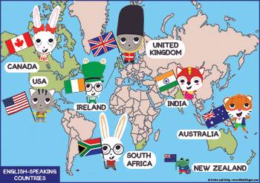
(LISTENING & WRITING)
Unit 9: english in the world
Lesson 4: SKILLS 2

Slide 2
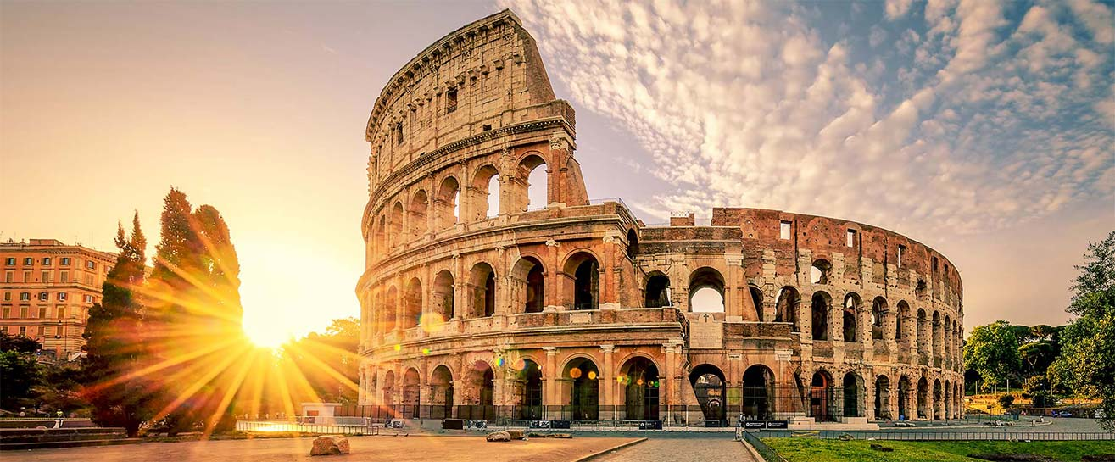
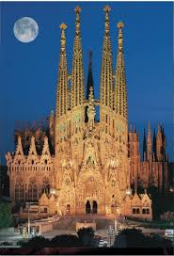
Tell me the name of A COUNTRY and A FAMOUS PLACE that is suitable with each picture
Rome colosseum - Italy
Sagrada Familia of Barcelona - Spain
Eiffel towe - France
TV tower - German
Bigben - England

Slide 3
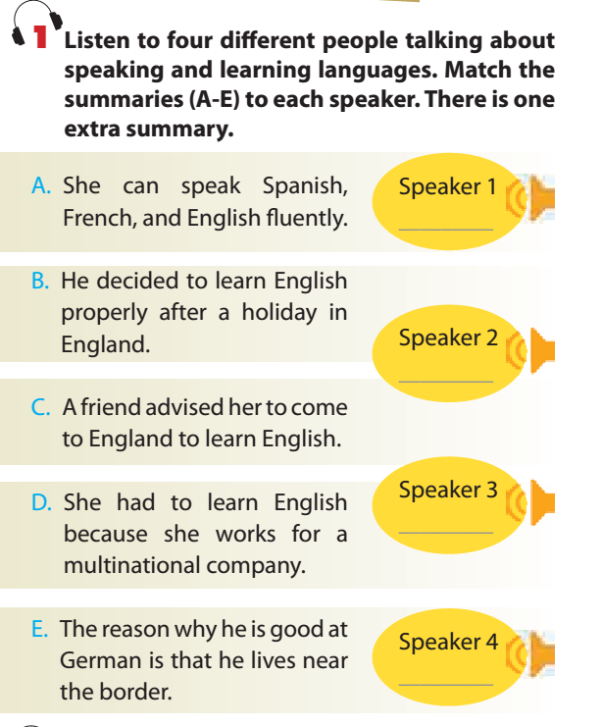
E
A
B
D

Slide 5
1. What did speaker 1 do last summer? A. He went to Rome. B. He went to Paris. C. He went to Berlin.

Slide 6
2. How can Speaker 2 speak Italian? A. A bit rusty B. fluently C. very well

Slide 7
3. What was Speaker 3’s level of English in the past? A. reasonable B. very bad C. good

Slide 8
4. What did Speaker 3 do while travelling around England?
A. He didn’t pick up any words and phrases
B. He noted down some words and phrases to learn. C. He picked up enough words and phrases to get by.

Slide 9
5. What did Speaker 4 think of her English learning?
A. She has not learned a lot at an English centre.
B. She has learned a lot at an English centre.
C. She couldn’t find any communicative way to learn English.

Slide 11
Watching a video about reasons to learn English. Try to take notes

Slide 12
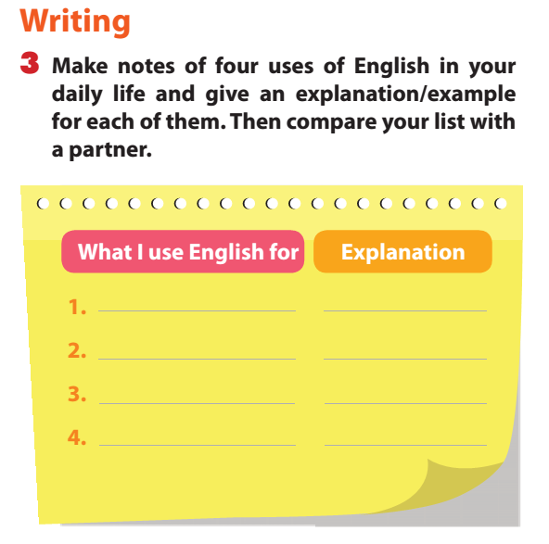
To communicate
To talk/ chat; to write ….
To learn/study
To read English books/materials; learn with English teachers……
To have a mean of relax
To watch E films, listen to E songs
To work in a multinational company
English co-workers; official language,….

Slide 13
Make a complete paragraph about the reasons to learn English by giving clues
Opening
I use English for different purposes in my everyday life
First idea:
English / help / me / communicate/ people / the world.
I / can / chat / talk / friends / because/ English/ be / international language.
I/ be able to/ use English to write /letters / emails/ my English friends.
Second idea
English / help / me/ in leaning .
I / can/ read/ English books/ materials/ English.
I / can/ attend/ classes taught / English teachers.
Third idea
English/ be/ a mean/ relax.
I / can/ English films/ movies/ English songs.
I / may/ novels/ English.
Closing
In conclusion, English is useful for me in various ways.

Slide 14
Make a complete paragraph about the reasons to learn English by giving clues
Opening
I use English for different purposes in my everyday life
First idea:
English / help / me / communicate/ people / the world.
I / can / chat / talk / friends / because/ English/ be / international language.
I/ be able to/ use English to write /letters / emails/ my English friends.
English helps me communicate with people all over the world. ………..

Slide 15
hOMEWORK
Write the parephrap
Prepare a 45-minute test (Unit 7,8,9) – (Next week)

